Slide 1
SPCIALIZED U
Future focused
R.M.S.Bandara
2021s18769
Notes:
Good morning, everyone. My name is Sandadini Bandara. Today, I'm going to present my app, which is set to transform how we handle student specialization selections at our faculty.

Slide 2

SPECIAL SELECTION APP
Notes:
Today, I'm going to introduce Specialized U, the app designed to assign students to their specialization subjects.
In the next few minutes, I'll walk you through the key features of my app and its benefits to our faculty, and how it's set to transform our selection process.

Slide 3
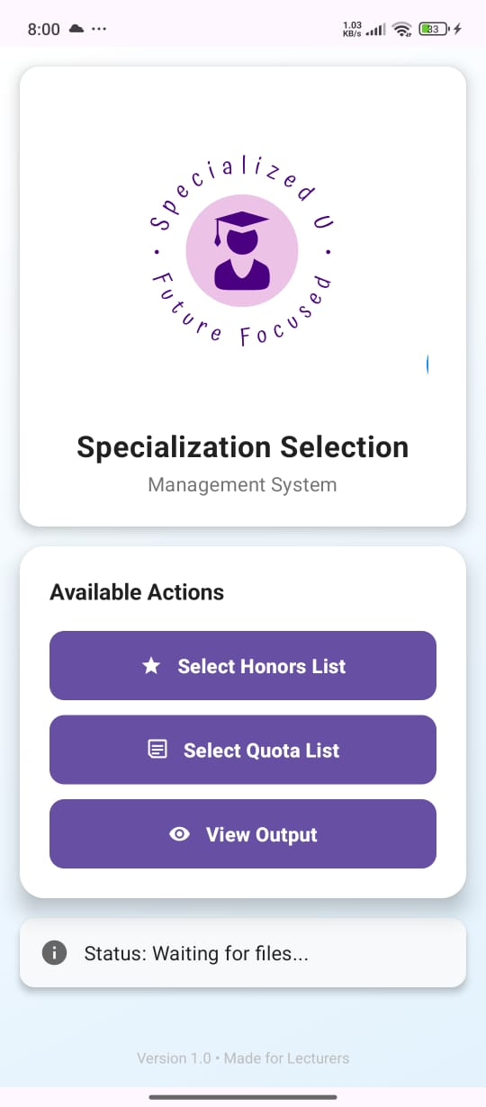
Advantages
Time-saving:
Efficiency
Fairness
Data management
Scalability
Notes:
Specialized U transforms student selection by automating the entire process, reducing what once took hours or days to mere minutes. It optimizes matches based on student preferences and quotas, ensuring an objective, bias-free outcome. By centralizing all data, the app simplifies access and maintenance, outperforming traditional methods. As our institution expands, Specialized U scales effortlessly, maintaining consistent performance regardless of data volume.

Slide 4
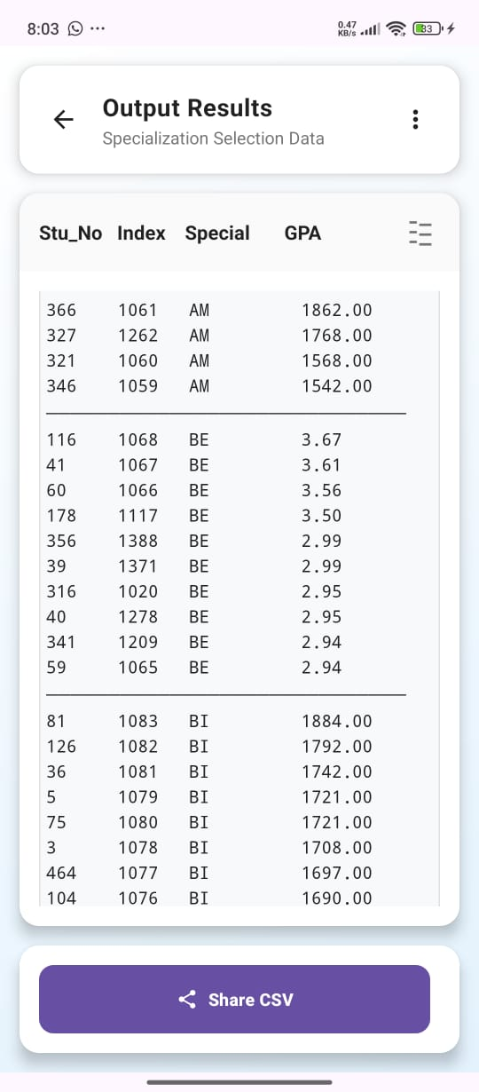
Advantages
Output format
User-friendly
Cost-effective
Data analysis potential
Modernization
Notes:
Specialized U outputs results in universally compatible CSV format, simplifying sharing and further processing. Its user-friendly design requires no technical expertise, ensuring easy adoption by lecturers. The app significantly cuts administrative time and costs, reducing the need for extra staff during selection periods. With digital data, we can analyze trends and gain insights for future planning. Specialized U reflects our commitment to modernizing processes and embracing educational technology.

Slide 5
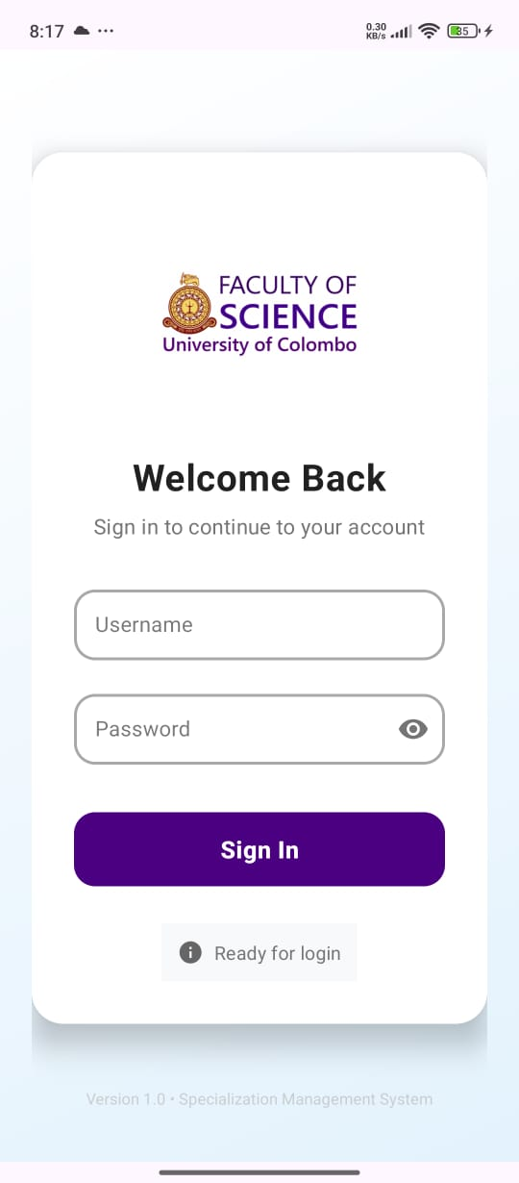
Layout
Login
Home page
output
Notes:
As u can see this is very user friendly.
This app automates this entire process. We simply have to input student preferences and quotas, and the app does the rest, producing results in a shareable CSV file.
This app opens doors for further innovations in how we manage academic processes, setting a new standard for administrative efficiency in our faculty.

Slide 6
THANK YOU

